Slide 1
Welcome to my MVC lecture!
Understanding MVC in Web Development!
Over the last 20 years websites have gone from simple web pages with html and css to incredibly complex applications. To make working with these complex applications much easier, developers use different patterns to lay out their projects to make code less complex and easier to work with, by far the most popular of these patterns is MVC

Slide 2
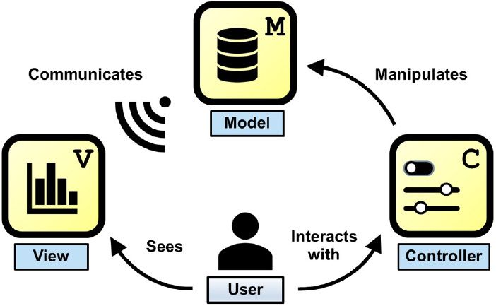
What is MVC
MVC stands for:
Model
View
Controller
MVC is a software architectural design pattern.
Purpose:
Separating application functionality,
Promotes organised programming

Slide 3
The Components of MVC
Model
Brain of the application
Responsibilities Data-related logic, interactions with the database, communicates with controller. Model is responsible for handling all of the data logic of the request, this means that the model interacts with the database and handles all validation, saving, updating deleting etc of the data
View:
Definition: Visual representation of the model. This is the UI, what the end user sees. Usually consists of html/css,
Responsibilities: Rendering UI, communicating with the controller, template engines - ejs
Controller:
Definition: Organizational part of the user interface.
Responsibilities: receives and coordinates input from view. For example user visiting page, processes requests (GET, POST, PUT DELETE), gests data from the model, passess the data to the view.

Slide 4
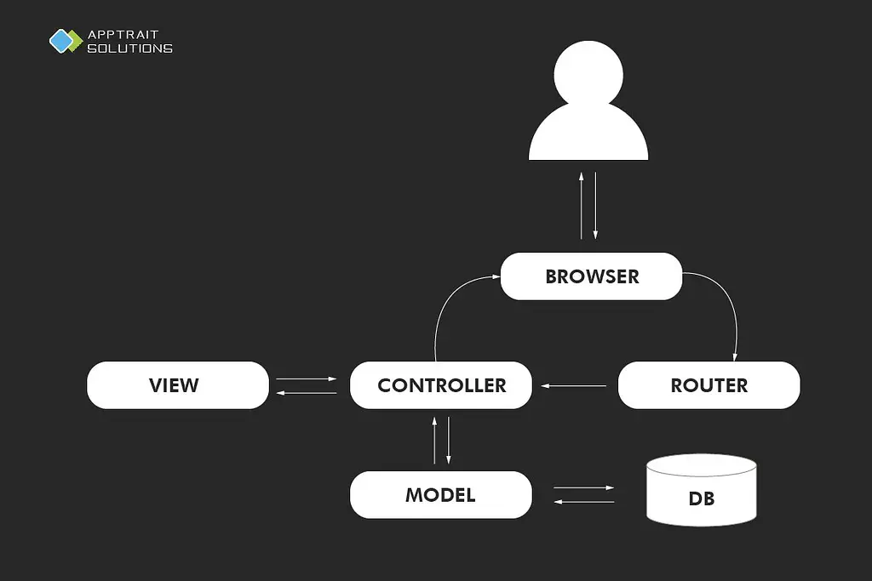
MVC in practice
Explanation of MVC workflow using an example:
User sends a request to the server
Controller handles the request, interacts with the model
Model processes data logic, interacts with the database
Controller retrieves data from the model, passess it to the view.
View renders the data into HTML for presentation
Controller sends the presentation back to the user

Slide 5
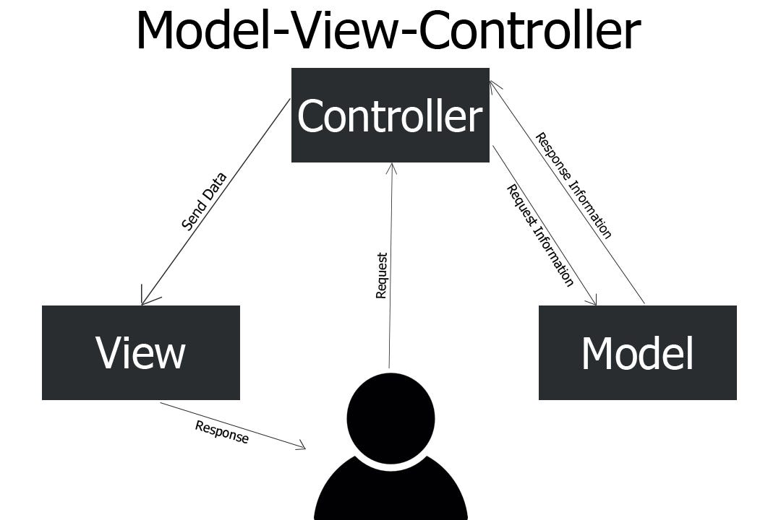



Example
Let me break it down for you:
1. User Requests List of Cats: User sends a request.
2. Request Reaches Controller: Routed to cat controller.
3. Controller Communicates with Model**: Requests cat data.
4. Model Retrieves Cat Data: Queries database.
5. Model Responds to Controller**: Sends back cat list or error.
6. Controller Processes Model's Response**: Handles success/error.
7. Controller Interacts with View: Asks view to render HTML.
8. View Renders Presentation: Renders cat list into HTML.
9. Controller Returns Presentation to User**: Returns HTML to user.
10. Error Handling: If error, different view handles error presentation.
This flow ensures a separation of concerns between data manipulation (Model), user interface (View), and application logic (Controller), making the application more modular, maintainable, and scalable.

Slide 6
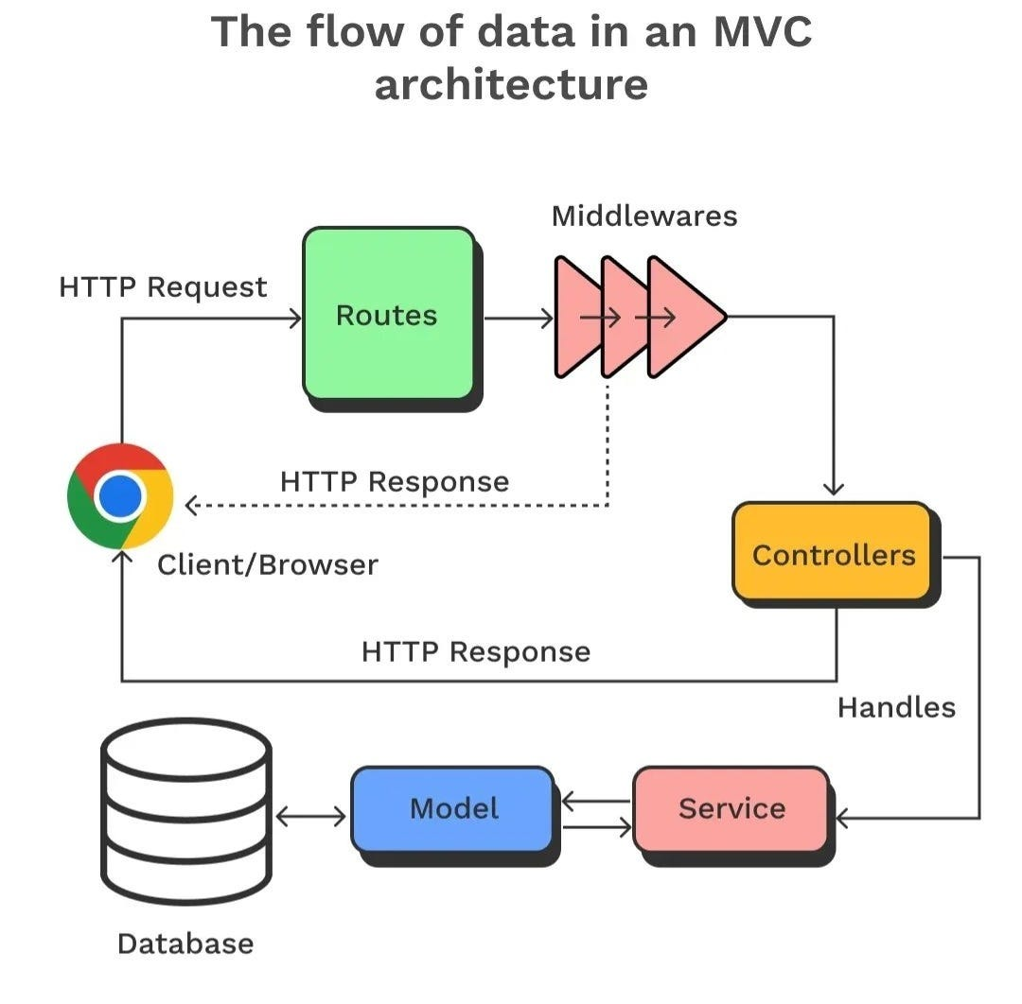

Slide 7
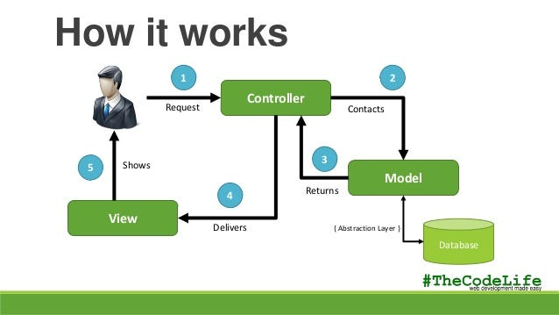

Slide 8
MVC benefits & Things to note
Prevents code repetition
Facilitates structured programming
Enhances organization and maintainability of codebases
Importing thing to note
Model and view never interact each other
Any interactions between model and view are done through controller
The router receives request from client, hands in requests to the controller

Slide 9
MVC frameworks
List of popular web frameworks utilizing MVC:
Ruby on Rails
Django
Laravel
Codeigniter
Express.js
Angular
etc.

Slide 10
Conclusion
In summary, MVC architecture plays a fundamental role in modern web development by providing a structured approach to organizing code and separating concerns. The model, representing the data layer, ensures efficient management and manipulation of data. The controller acts as the traffic controller, orchestrating interactions between the model and the view. Finally, the view presents data to users in an understandable format and allows for interaction with the application.
This clear separation of responsibilities offers numerous benefits, including improved code organization, modularity, scalability, and testability. By embracing MVC principles, developers can create robust and maintainable web applications that deliver enhanced user experiences.
As you continue your journey in web development, I encourage you to delve deeper into the intricacies of MVC architecture and explore its applications in different frameworks and technologies. Experiment with building your own MVC-based projects, and consider exploring advanced topics such as middleware, routing, and dependency injection. By continuously learning and expanding your understanding of MVC and other architectural patterns, you'll become a more proficient and versatile developer, capable of building even more sophisticated and efficient web applications. Keep exploring, experimenting, and pushing the boundaries of your knowledge – the possibilities in web development are endless!

Slide 11
Q&A
Questions and discussion

